Slide 1

Capstone Project - Contoso Air
Team Members: Raihan Mohamed Vaishnavi Chennapragada Shivani Gudiboyana Sobiya Kumar

Slide 2



Personal BACKGROUND
(Name, Past Experience, Qualification, Career Summary)
Team : ContosoAir
Batch – HP QE (Batch –2)
Project Summary : ContosoAir is a web-based flight booking application that allows users to search, book, and manage flights with real-time pricing and availability. The project mainly focused on automation testing using Java, Selenium, and IntelliJ to ensure both front-end and back-end functionality. MongoDB was used for database management, while Node.js and npm supported project setup and dependency handling. API testing was performed using Postman, and JMeter was used to measure system performance under load. Test planning and tracking were managed in Jira, with manual and UAT test cases written using Zephyr. Docker was used to simulate secure and consistent test environments throughout the testing process.
www.collaberadigital.com

Slide 3


Key Takeaways/Learnings from the Program (HTD)
Automation Testing - Understanding software testing basics, test planning, automation principles, and exploratory testing. Gained exposure to QE in DevOps and evolving test strategy alignment.
Agile & Jira - Learned Agile methodology and Scrum framework with Jira setup and navigation. Practiced sprint planning, issue tracking, and Waterfall model comparison.
Selenium with Java - Learned Java collections, file handling, and basics of automation framework. Developed Selenium scripts for web automation using Java.
Python & Selenium with Python - Understood Python syntax, sequences, and file operations. Automated browser testing workflows using Selenium and Python.
Git - Learned Git commands, version control, and repository handling. Practiced collaboration on GitHub with branching and merging.
Non-Functional Testing (NFRs) - Understood the role of QA in validating non-functional requirements. Learned about performance, security, usability, and accessibility testing.
Performance Testing - Learned types of performance testing using JMeter and LoadRunner. Analyzed key metrics like response time, TPS, and system bottlenecks.
Security Testing - Studied OWASP Top 10 vulnerabilities and secure testing practices. Gained awareness of tools like Burp Suite and OWASP ZAP.

Slide 4

Key Takeaways/Learnings from the Program (HTD)
Extended NFR Types - Learned about usability, compatibility, scalability, and reliability testing. Focused on system maintainability, portability, and installability.
Tooling Overview - Got familiar with accessibility and compatibility tools like Axe and Browser Stack. Understood installability and recovery testing using automation tools.
NFR in Agile - Practiced shift-left strategy and embedding NFRs into Agile workflows. Learned to raise, prioritize, and track NFR-related bugs effectively.
API Testing with Postman - Learned REST API testing concepts and using Postman for request handling. Worked with GET/POST methods, headers, body, and chaining requests.
Postman Advanced - Wrote assertions, used variables, and built request collections. Explored productivity tools like Monitors and Newman (awareness level).
Wrap-up - Reflected on QA’s evolving role in NFR validation across SDLC. Reinforced learning through Q&A, quizzes, and summary discussions.
Case Study / Group Work - Applied NFR planning to a public-facing eCommerce web app. Collaboratively built and presented a mini NFR test plan matrix.

Slide 5

Problem Statement of the Capstone Project
ContosoAir is a web application made for booking flights and managing travel plans. Users can search for flights, book tickets, and make changes to their bookings with real-time prices and availability. The app is built to be fast, secure, and able to handle many users. We used MongoDB to manage the data. For planning and tracking our work, we used Jira during each sprint. The project focused on creating a smooth and user-friendly experience.

Slide 6

Environment Setup of the Capstone Project
Install IntelliJ IDEA, Node.js, Git, and Java version 18 on your system.
Set up MongoDB locally or on a remote server, configure it, and obtain the connection string.
Open or create the project in IntelliJ and configure project structure and settings if needed.
Use npm to install all required project dependencies after verifying Node.js installation.
Clone the project repository using Git, install the dependencies, and configure environment variables (e.g., MongoDB connection string, API keys).
Integrate and use Selenium for browser-based test automation in the project.

Slide 7

Testing Tools and Methodologies for Capstone Project
Postman was used for API testing, validating request-response flows and testing REST endpoints.
JMeter was used for performance testing to simulate user load and measure system responsiveness.
Jira was used for test planning, sprint tracking, and managing user stories, tasks, and bugs.
Selenium was used for automation testing to validate UI workflows across browsers.
Docker was used for security testing by deploying applications in isolated containers to test in secure environments.
MongoDB served as the backend database, and Java (v18) with Node.js and IntelliJ was used to develop and test the application.

Slide 8
Manual Testing
As part of the manual testing process for our application, ​we have written and executed User Acceptance Tests (UAT) to ensure that the ​system meets the business requirements and functions as expected from an end-user perspective.
The tests were designed and managed using Jira for efficient planning and execution.​
UAT test cases were organized into structured Test Plans and Suites in Jira.
Bugs and issues were logged and tracked through Jira for resolution.
Real-time test progress and results were monitored within Jira.
The focus was to validate functionality and user expectations before release.

Slide 9
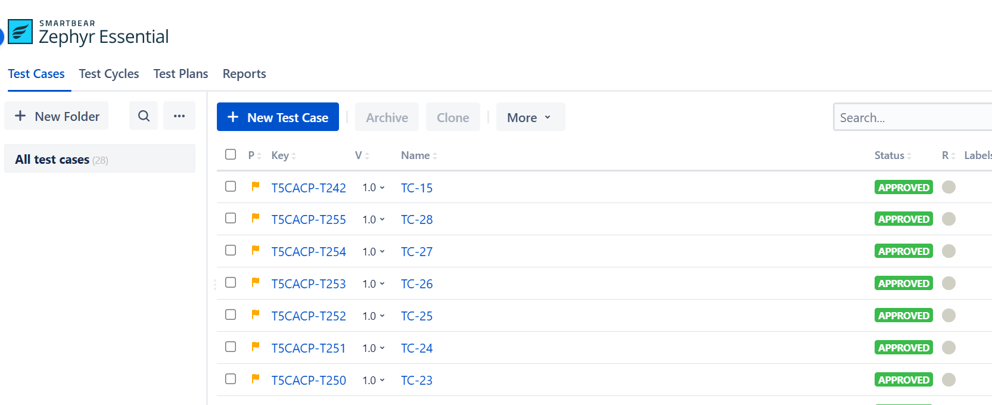
Test Case Design
Zephyr in Jira to design and manage detailed manual test cases for both front-end and back-end functionalities. Focusing on ensuring traceability, efficiency, and alignment with business requirements. Mapping each test case to corresponding tasks and epics to maintain clarity and comprehensive test coverage. Structured and repeatable testing practices.

Slide 10
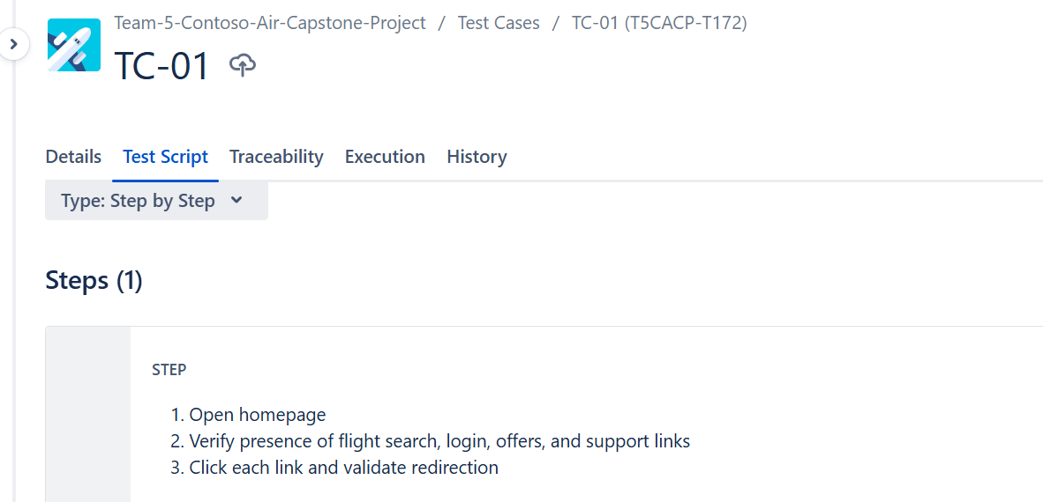
Test Suite Creation
Work Items

Slide 11
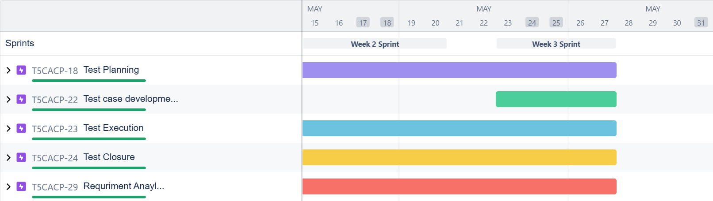
Jira sprint Graph

Slide 12
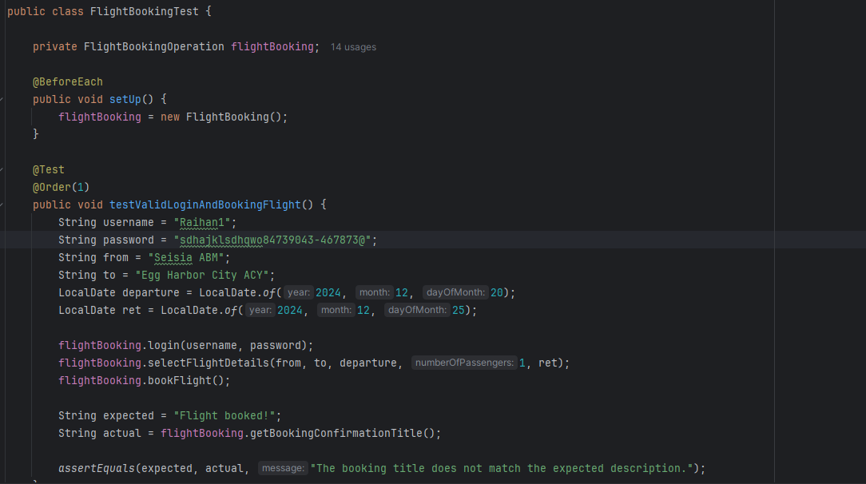
UAT Testing

Slide 13
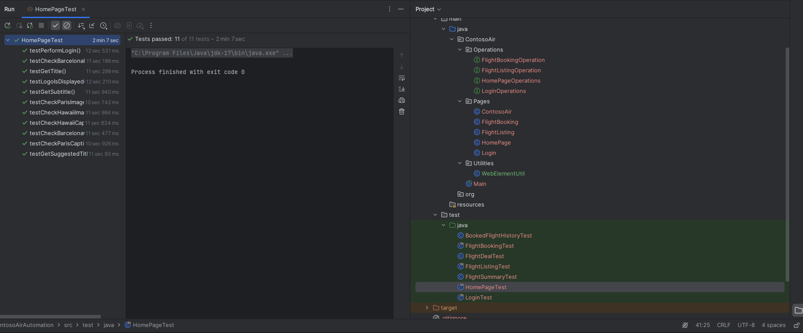
Automation Testing

Slide 14
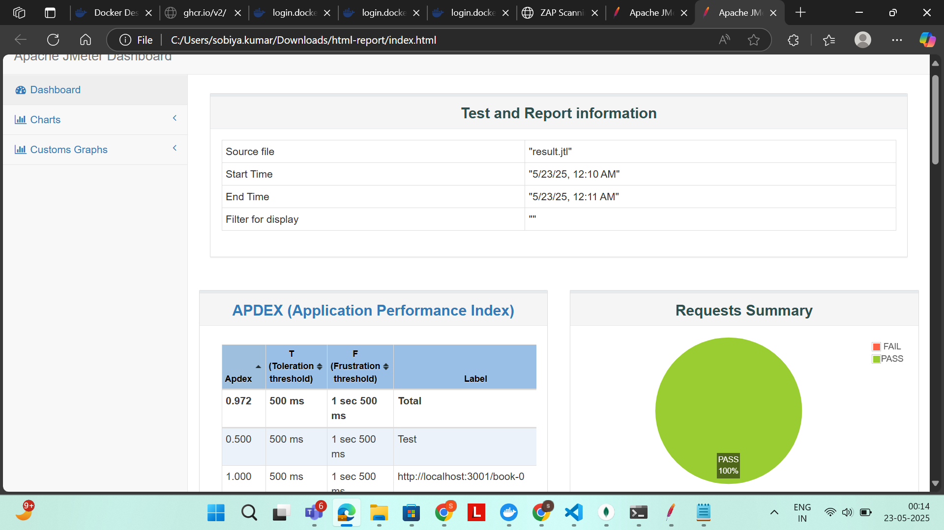
Performance Testing

Slide 15
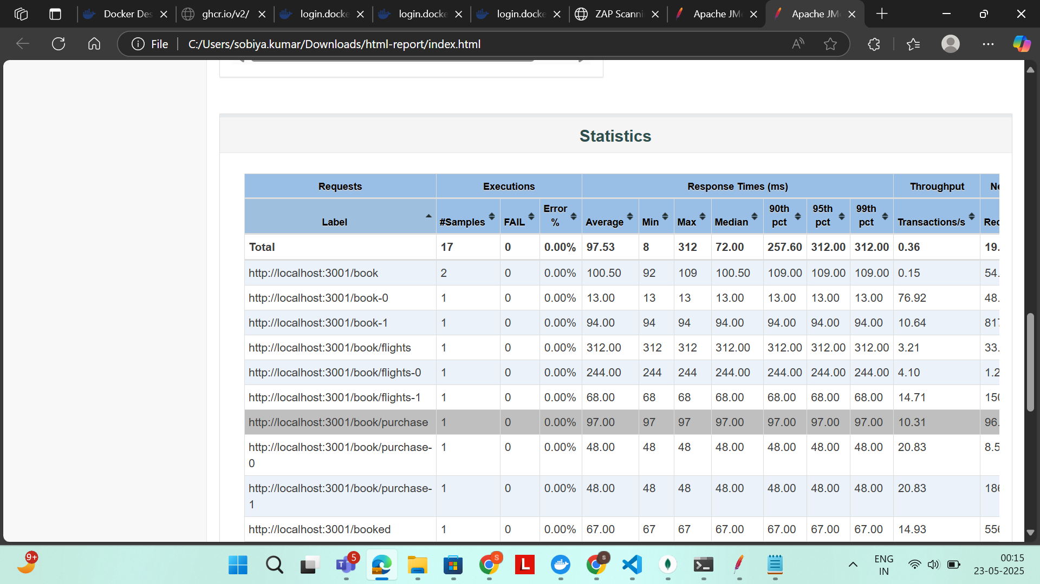
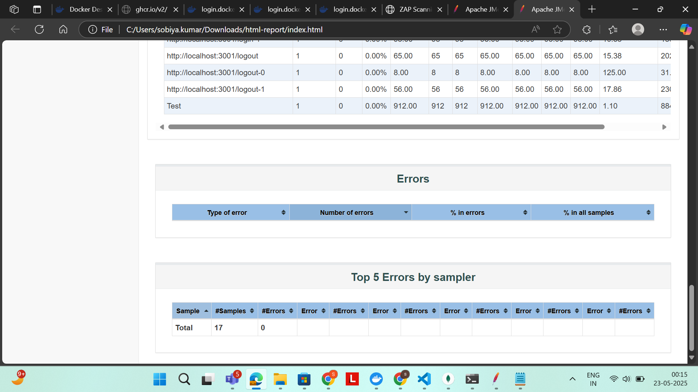
These are the test reports that are generated using command prompt for performance testing

Slide 16
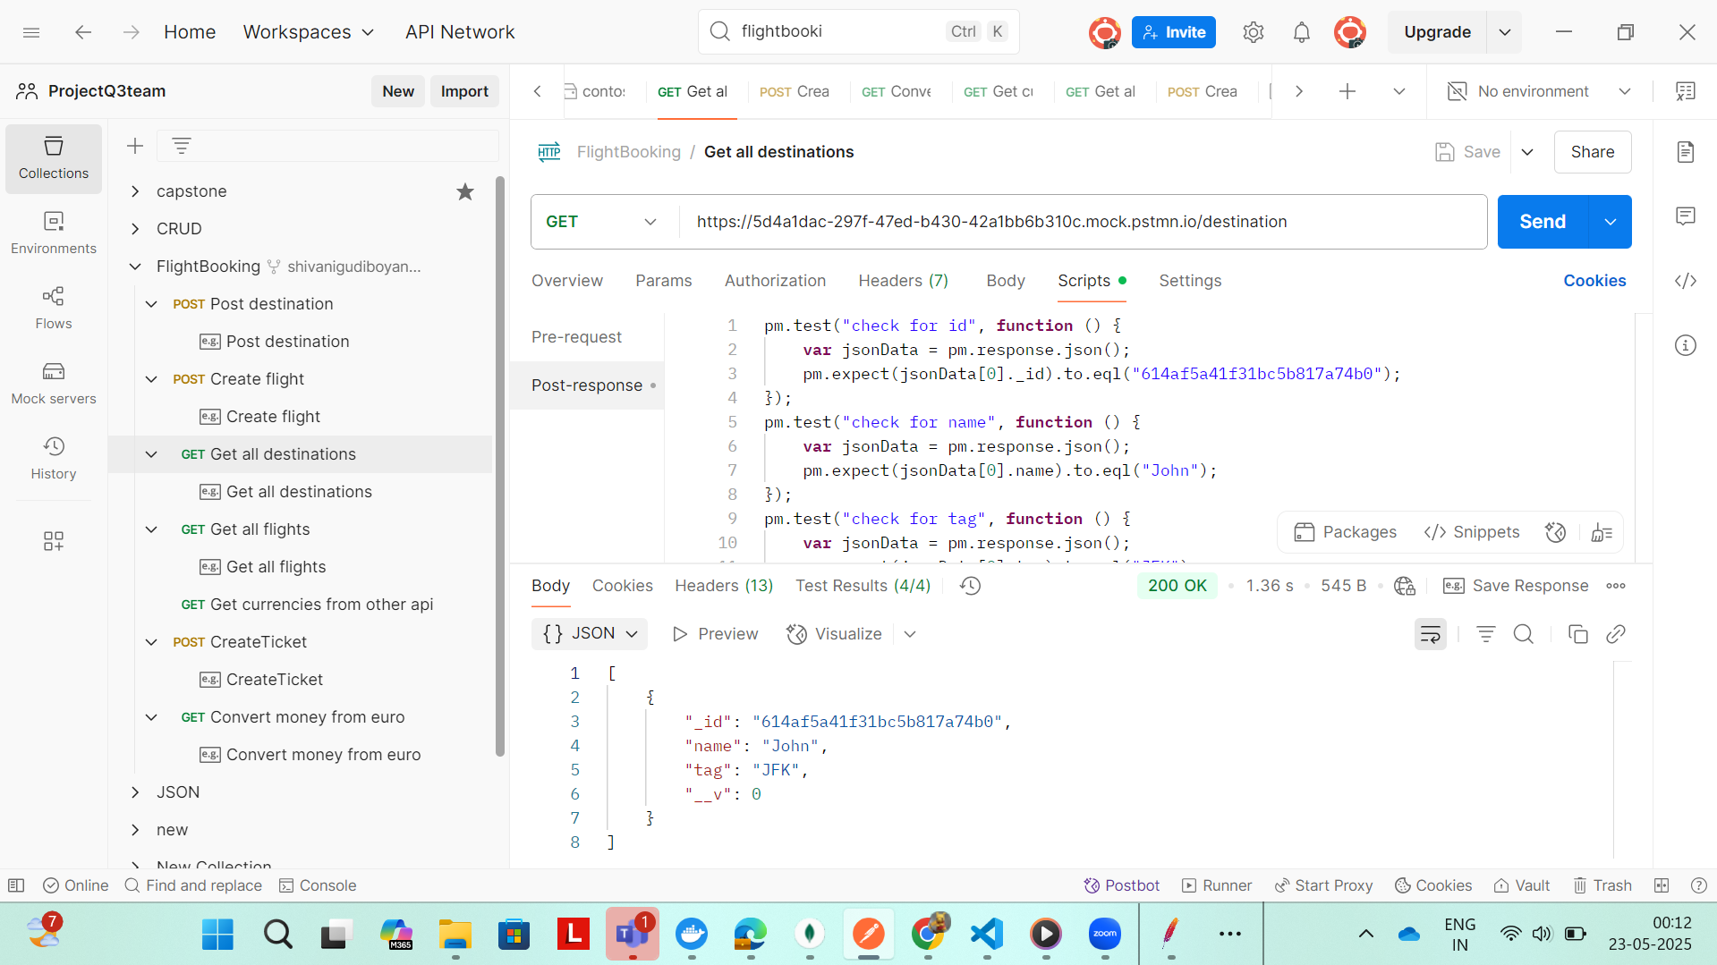
API Testing

Slide 17
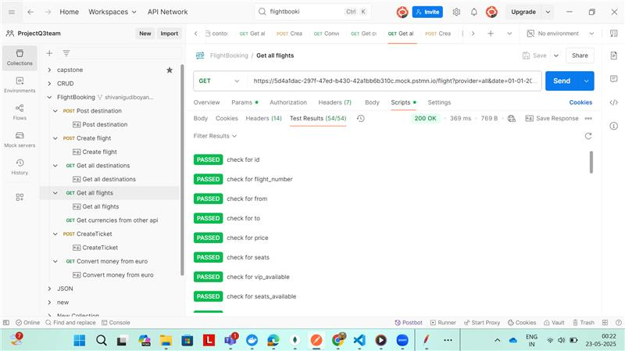
API Testing

Slide 18
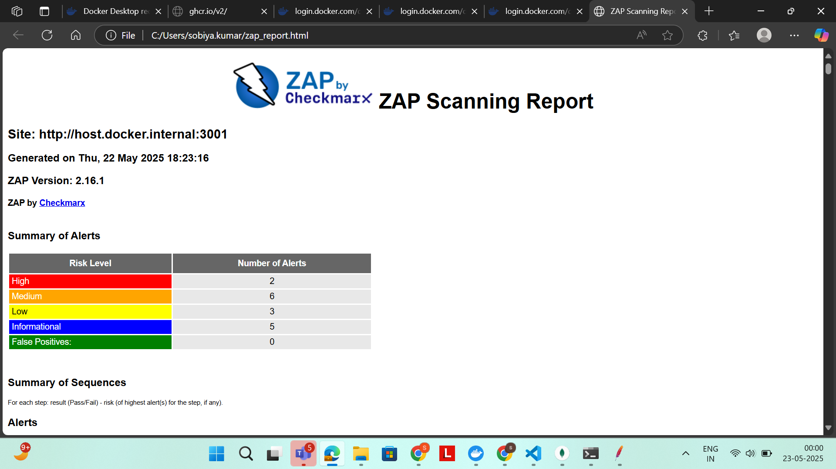
Security Testing

Slide 19
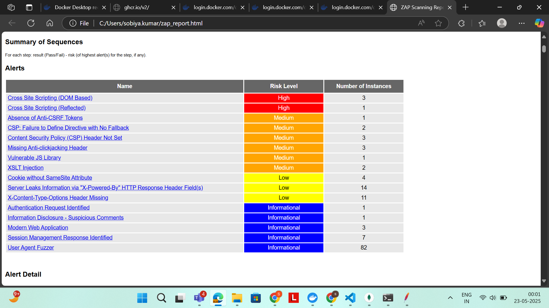

Slide 20
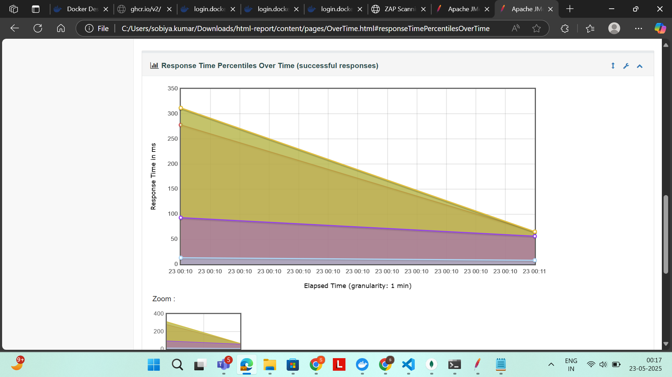
HTML REPORT
Response Time Percentiles Over Time

Slide 21
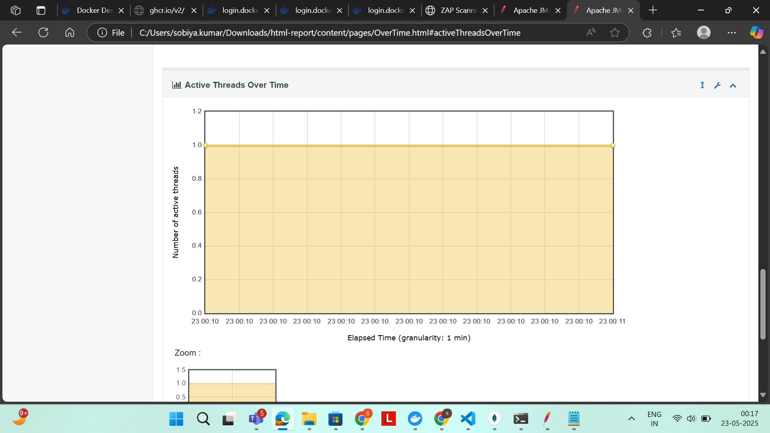
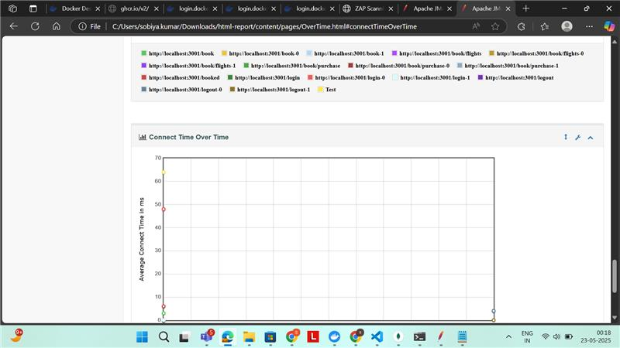
Active Threads Over Time
Connect Time Over Time

Slide 22
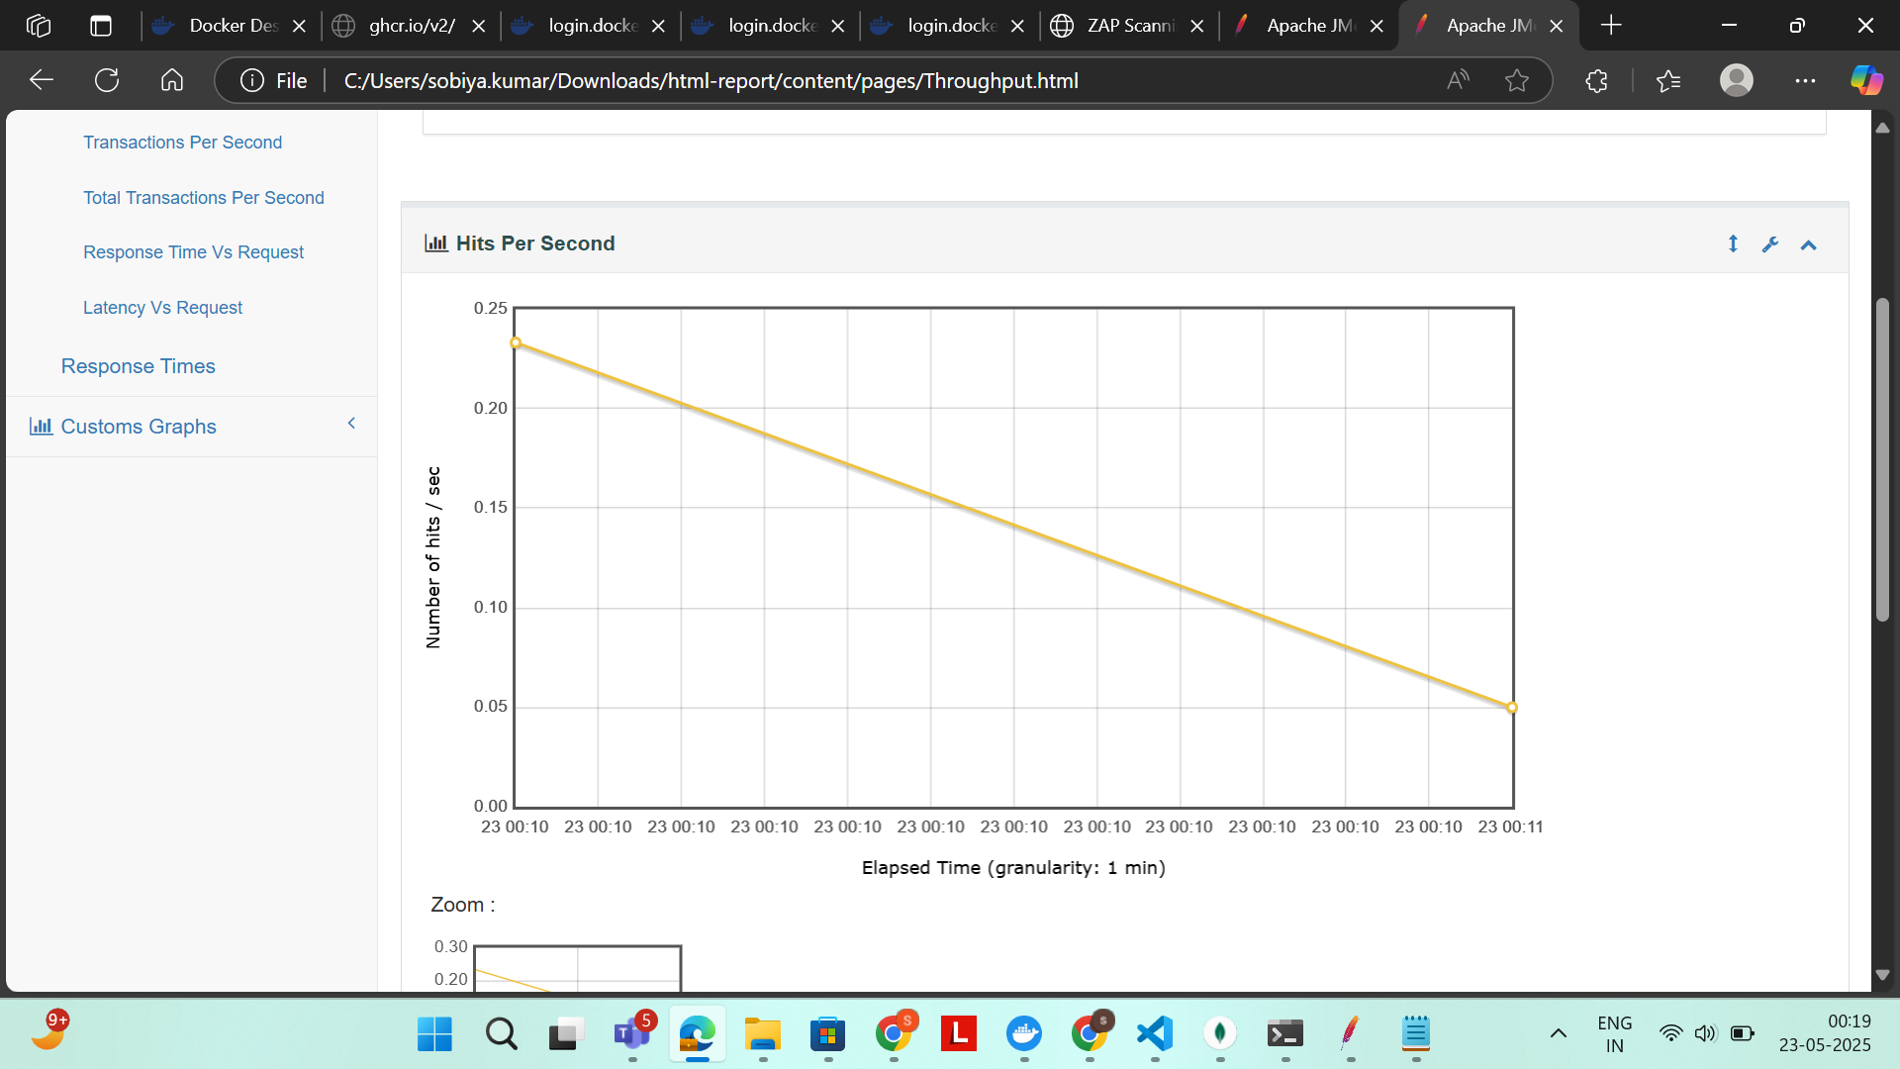
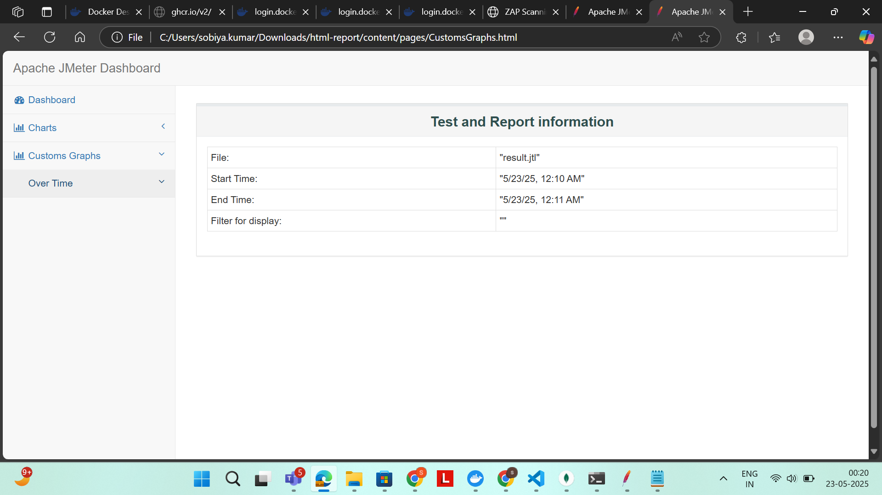
Throughput Outputs
Hits per second
Custom Graph

Slide 23
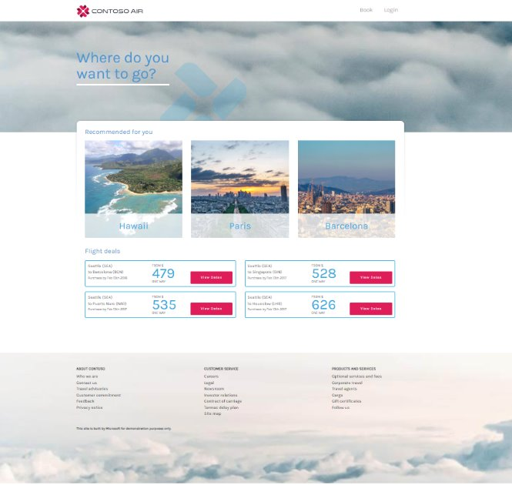
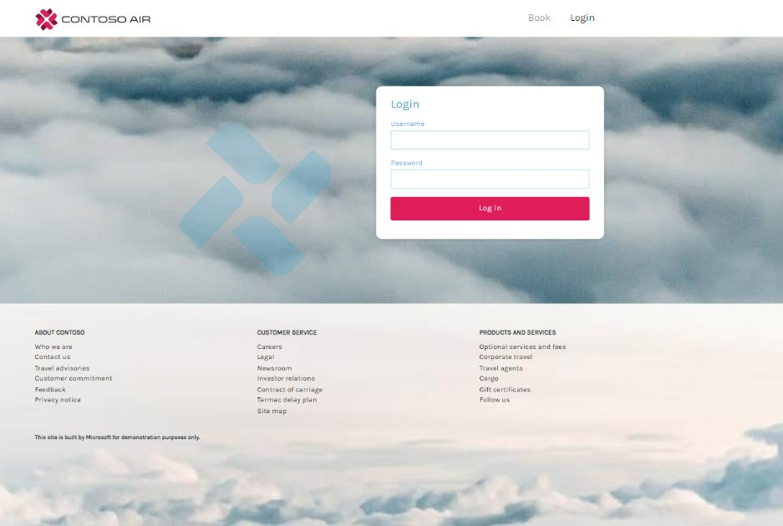
Important areas of the Project with screenshots

Slide 24
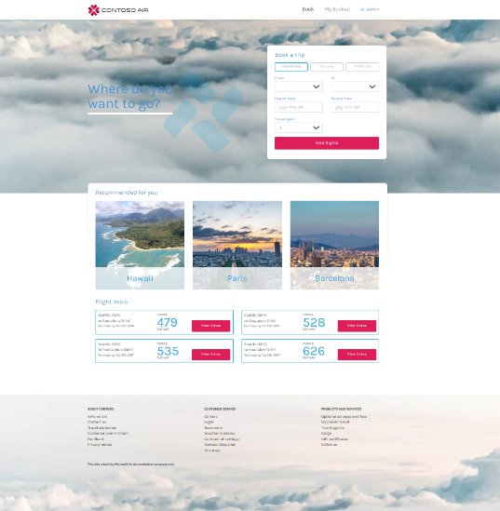
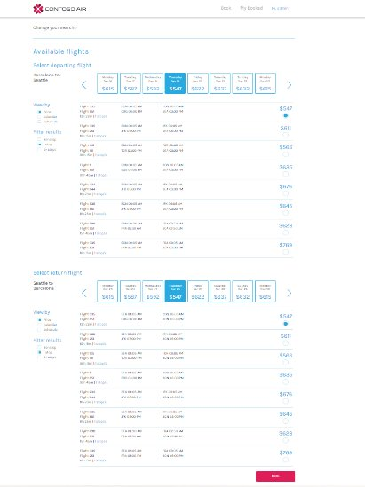
Important areas of the Project with screenshots

Slide 25
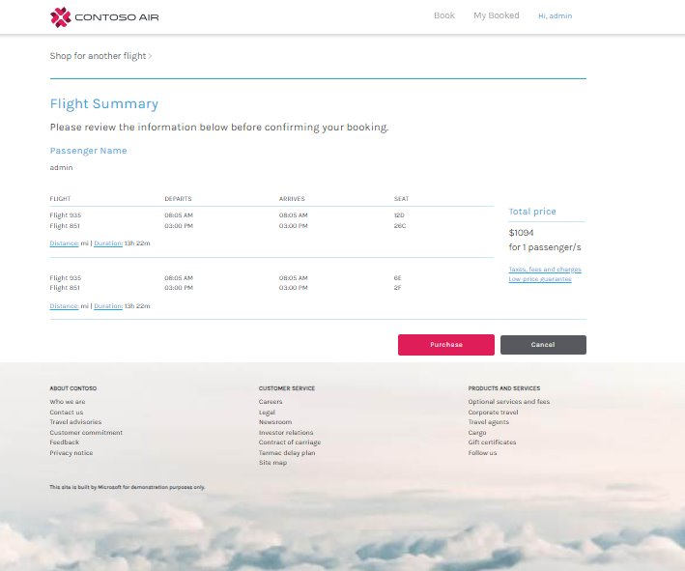
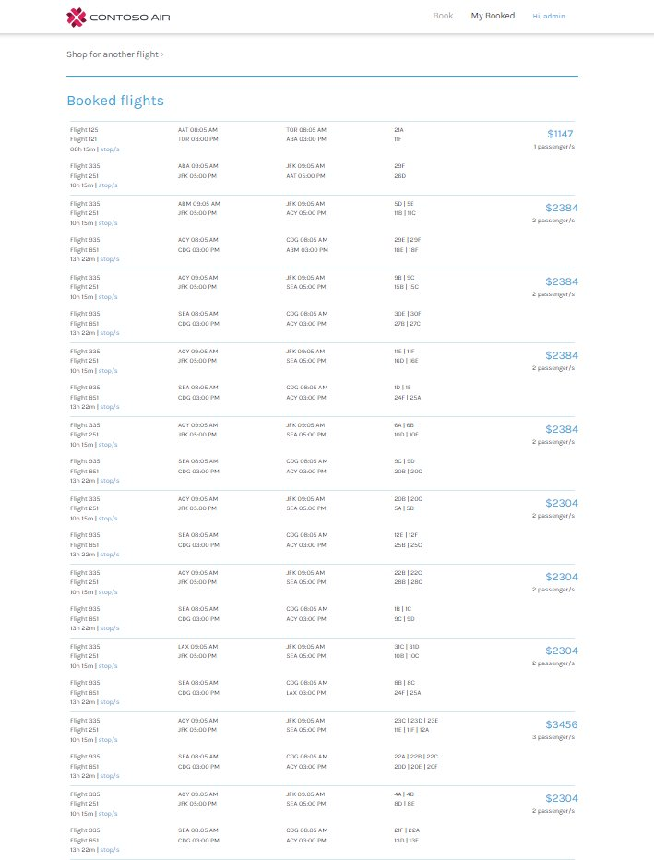
Important areas of the Project with screenshots

Slide 26
Conclusion
I learned many key skills in software testing and development. I practiced manual testing, understood the Software Development Life Cycle (SDLC), and followed Agile processes. I wrote SQL queries and improved my Java programming. I used Selenium for test automation and MongoDB for testing databases. I worked in IntelliJ for coding and managed my code using Git. I built and ran projects using Node.js and npm. I tested APIs using Postman and performed performance testing with JMeter. I used Jira to plan and track testing activities and explored Docker for secure, repeatable test environments. By applying all these skills in my Capstone Project, I gained real-world experience and prepared myself for a professional role in software testing.

Slide 27

References
(Files uploaded in our respective folder)
SRS for ContosoAir
Automation Test scripts using Java
Jmx and csv files of Performance Testing
API collection Folder for API Testing
Daily Scrum Notes
Test Case Design Technique

Slide 28
Thank You

